Slide 1


Unit 1
Preparing for data review and description
Notes:
Welcome to Unit 1 of Module 3.
In this unit we will look at how to prepare the data analysis team for conducting the data review and description process.

Slide 2
By the end of this unit, you will:
summarize what the data analysis team needs to know before starting the data review process
describe the organization of indicators in the indicator inventory and data analysis platforms
identify different types of HHFA indices
Notes:
By the end of this unit, you will:
summarize what the data analysis team needs to know before starting the data review process;
describe the organization of indicators in the indicator inventory and data analysis platforms; and
identify different types of HHFA indices.

Slide 3

Preparing for HHFA data review and description
Key preparations include:
reviewing the HHFA objectives, survey design, and implementation challenges
reviewing the structure of the HHFA indicator inventory platform
well-prepared data analysis team
recognizing the relationship between the indicator inventory and the analysis platform
Notes:
Before starting the review of the analysis platform outputs, it is important that the HHFA data analysis team is well prepared.
Key preparations include:
reviewing the HHFA objectives, survey design, and any implementation challenges;
reviewing the structure of the HHFA indicator inventory platform; and
recognizing the relationship between the indicator inventory and the analysis platform.

Slide 4
Review of HHFA objectives, survey design, implementation challenges
The data analysis team must be aware of:
factors that may impact the collection and quality of the HHFA data
how these factors may affect analysis and interpretation of the data
Factors include:
decisions made during the survey planning stage
implementation limitations and errors
Notes:
The data analysis team must be aware of factors that may impact the collection and quality of the HHFA data, and how these factors may affect analysis and interpretation of the data.
These factors include decisions made during the survey planning stage, as well as any implementation limitations and errors.

Slide 5

Review of HHFA objectives, survey design, implementation challenges
Country HHFA planning and design decisions, for example:
Decisions will affect:
HHFA objectives
data and indicators available
HHFA modules
level of analysis
question types (core/additional)
comparisons
changes to questionnaire
HHFA Comprehensive guide
(Box 4)
survey design methodology
Notes:
The data analysis team must be aware of the following decisions related to survey planning and design:
the HHFA objectives and their underlying questions;
the HHFA modules that were implemented;
the question types that were implemented: core only or core plus additional;
any changes to the standard HHFA questionnaire.
the survey design methodology - for example:
was the HHFA based on a census of all facilities or on a sample?
what type of sampling was used and what was the sample size?
These decisions will affect:
the data and indicators that will be available for review;
the level of analysis that is possible (e.g. national or subnational); and
the comparisons that can be made.
Box 4 in the HHFA Comprehensive guide highlights the importance of considering the survey design when making comparisons across subnational areas.

Slide 6
Review of HHFA objectives, survey design, implementation challenges
Country HHFA limitations and errors may include problems with:
Challenges can affect:
master facility list
data accuracy and precision
sampling
data collection
data management
Notes:
The analysis team also needs to consider any limitations and potential errors in the country HHFA.
These may include problems with:
the master facility list (e.g. an incomplete list, or duplication of facility names);
sampling (e.g. inadequate design and sample size for the survey’s objectives);
data collection (e.g. non-response); or,
data management (e.g. loss of data).
Such challenges can affect the accuracy of the data and the precision of the indicator estimates.

Slide 7
Review of HHFA indicator inventory platform
Indicator inventory platform
organization
Data analysis platform
organization
The indicators are organized in the same way in both the indicator inventory and the data analysis platform.
Notes:
Before proceeding, it is also important for the data analysis team to have an overview of the structure of the analysis platform outputs and the way they are organized.
This can be achieved quickly by reviewing the service dimensions and their subsections in the indicator inventory platform.
The indicators are organized in the same way in both the indicator inventory and the data analysis platform.

Slide 8
Indicator organization in the indicator inventory platform
service dimensions
service areas
service sub-areas
tables
indicators
Notes:
The HHFA indicators are organized into 5 overarching groups called service dimensions.
Within each dimension, indicators are organized hierarchically into:
service areas;
service sub-areas; and
tables, which contain the indicators.

Slide 9
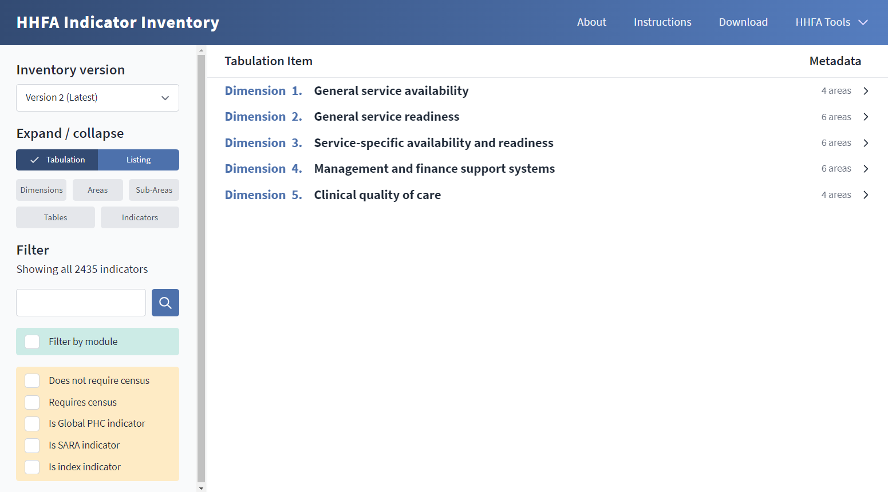




HHFA indicator inventory platform
Notes:
The 5 dimensions in the indicator inventory platform are:
General service availability;
General service readiness;
Service specific availability and readiness;
Management and finance support systems; and
Clinical quality of care.
The 5 dimensions broadly correspond to the 4 modules of the HHFA questionnaires.
Dimension 5 applies only to data from the record review questionnaires of the Quality of care module.

Slide 10
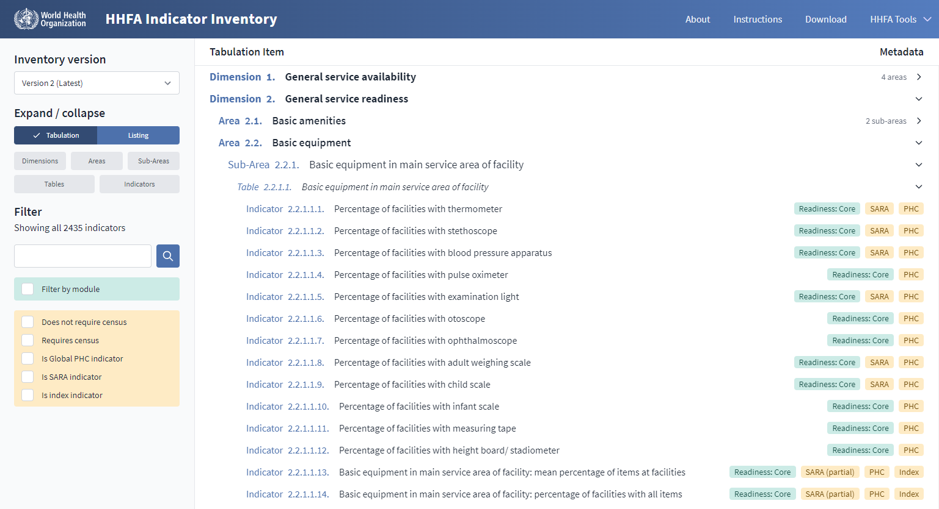
HHFA indicator inventory platform
Notes:
Let’s look at the organizational hierarchy within Dimension 2. It includes the
Area;
Sub-area;
Table; and
Indicators.

Slide 11
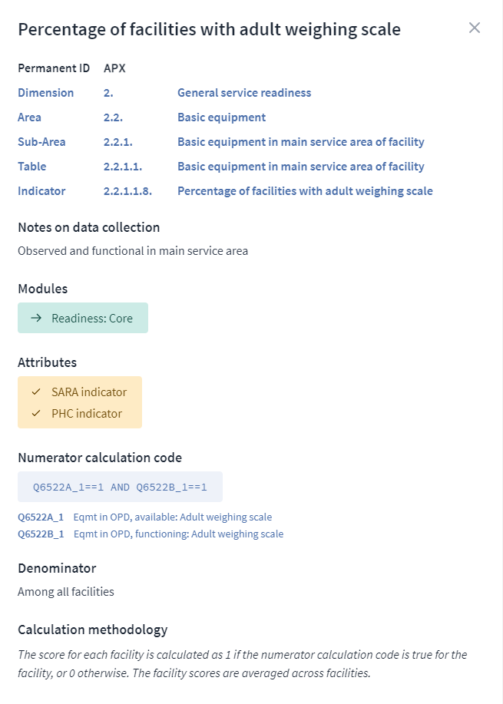
HHFA indicator inventory platform
Notes:
If you click on an individual indicator …
… a pop-up window displays information about the indicator.

Slide 12
HHFA indicator inventory platform
The indicator inventory is discussed in further detail in the OpenWHO course: Questions, indicators and country adaptation.
Notes:
Below the “Numerator calculation code” tab, the questions that provide data for the indicator are displayed.
In this example, questions Q6522A and Q6522B provide data for the indicator “% of facilities with adult weighing scale”.
The indicator inventory is discussed in further detail in the OpenWHO course: Questions, indicators and country adaptation.

Slide 13
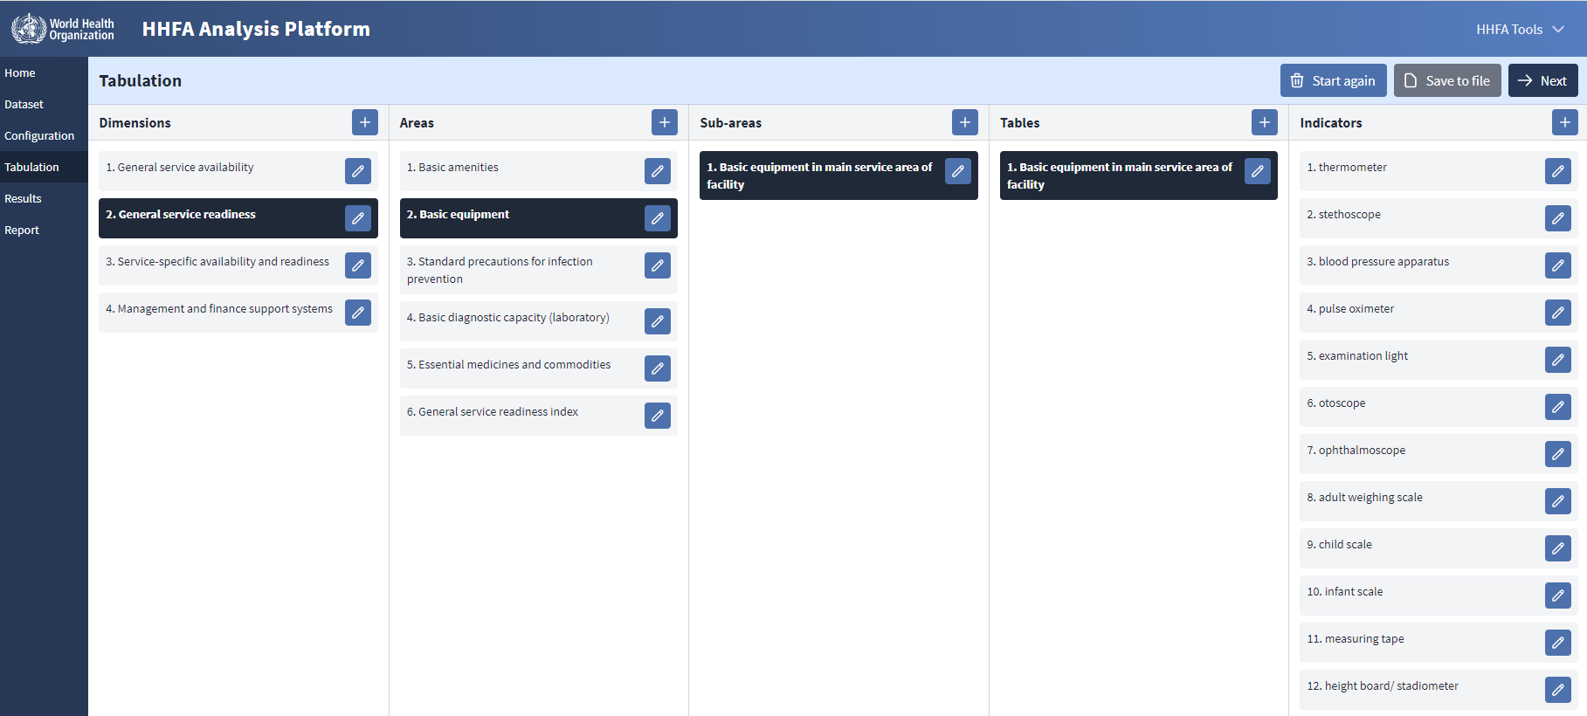
HHFA data analysis platform – tabulation view
Dimensions
Areas
Sub-areas
Tables
Indicators
Notes:
Let’s now look at how the same table is presented in the data analysis platform.
Note that here we are looking at the tabulation view of the analysis platform.
The indicators are listed in the columns on the far right of the screen.

Slide 14
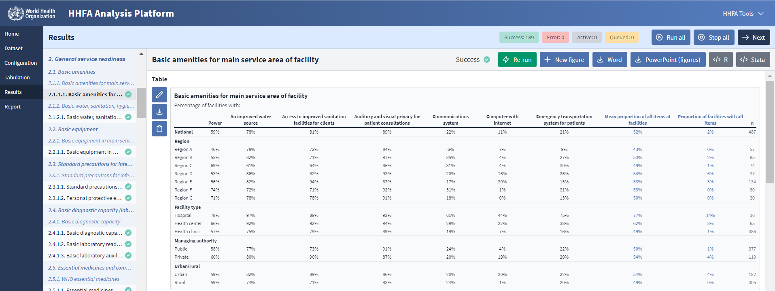
HHFA data analysis platform – results view
Notes:
This screen displays the same table but this time it shows the results view of the data analysis platform.
Here the indicator names are shown as the column headings.
The column second from left shows the dimensions, areas, sub-areas and tables. It is organized in the same way as in the indicator inventory platform.

Slide 15
HHFA indices
Group of indicators
%
%
Indices are useful for:
%
%
index
a quick overview of a situation
%
easily communicating information about a group of indicators
%
assessing changes over time or comparing subnational areas for the group of indicators
However, it is important also to look at the individual indicators that contribute to the index.
Notes:
Some HHFA indicators tables also contain indices. An index summarizes information about a selected group of indicators.
Indices are useful for:
getting a quick overview of a situation;
easily communicating information about a group of indicators; and
assessing changes over time or comparing subnational areas for the group of indicators.
However, it is also important also to look at the individual indicators that contribute to the index.

Slide 16
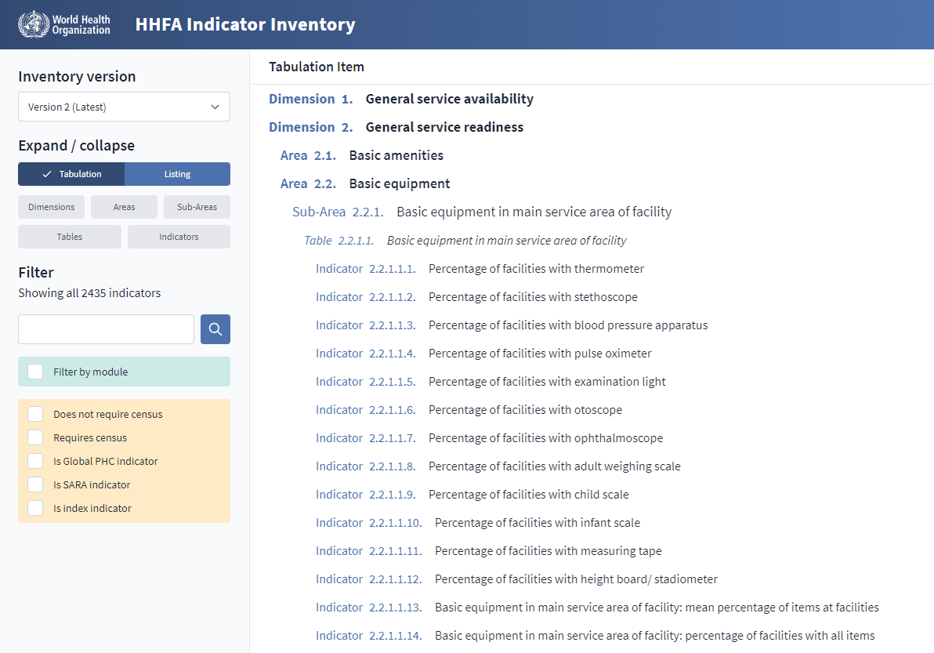
HHFA indices
HHFA Comprehensive guide
(Section 3.5 and Annex 1)
Overall readiness index
“With all items” index
Notes:
In the HHFA, indices are mainly used to reflect service readiness.
A readiness table contains indicators that each represent an individual item.
At the bottom of each readiness table are two indices, each referring to all the items in the table:
The mean (or average) percentage of items at facilities. This is the overall readiness index of the table.
The percentage of facilities with all items. This is the “with all items” index of the table.
For further details about HHFA indices, refer to section 3.5 and Annex 1 of the HHFA Comprehensive Guide.

Slide 17
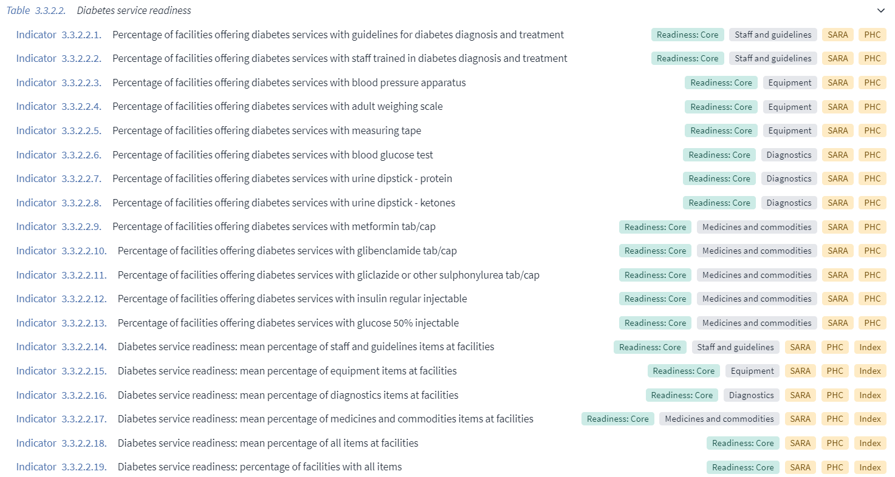
HHFA indices
Staff and guidelines indicators
Equipment indicators
Diagnostics indicators
Medicines and commodities indicators
Domain index
Domain index
Domain index
Domain index
Not every service-specific readiness table will contain all four domains.
Notes:
Service-specific readiness tables also contain domain indices.
In these tables, the indicators are grouped according to the following 4 domains:
Staff and guidelines;
Diagnostics;
Equipment; and
Medicines and commodities.
A domain index is calculated for the indicators in each domain.
Note that not every service-specific readiness table will contain all 4 domains, as this will depend on the items that are considered necessary for readiness of the particular service.

Slide 18
You have now completed Unit 1.
In the next unit, we will look at how to review the HHFA analysis platform outputs.
Notes:
You have now completed Unit 1.
In the next unit, we will look at how to review the HHFA analysis platform outputs.

